Slide 1
Using AI and open sources to protect Human Rights Defenders
@VILUA
Ana Luisa Zago de Moraes
Lutiana Valadares Fernandes Barbosa
Viviane Ceolin Dallasta Del Grossi

Slide 2


1. Context
Brazil is the 4th country in the world regarding killings of human rights defenders;
Average of 3 killings per month;
2019-2022:Brazil recorded 1,171 cases of violence against human rights defenders. Of the total, 169 were murdered.
https://agenciabrasil.ebc.com.br/radioagencia-nacional/direitos-humanos/audio/2023-06/quase-170-defensores-de-direitos-humanos-foram-assassinados-em-4-anos

Slide 3

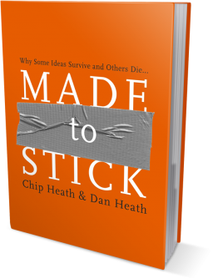
PROBLEM
How to use open source and AI to provide information to human rights defenders on the levels of risks they are facing?
https://github.com/Monsauce/VILUA/blob/main/README.md

Slide 4
Obstacle: objectification of risk.
Making risk objective can be done by means of network algorithms.
Moving from a self-perception of risk to an objectively measurable risk.
The next step is to establish metrics of the degree of risk.

Slide 5
Benefits of objectifying risk
Personal autonomy and self-protection;
Objective data for authorities;
Possibility of action in international human rights courts;
Inclusion In legislative proposals.

Slide 6
CORE VALUES
EXPLAINABILITY
TRANSPARENCY
NON SURVEILLANCE

Slide 7
Using codes and AI technology we can research open data to map the risks human rights defenders are facing. A combination of name, geolocation and key threaten phrases will provide information on the risks. Those risks will be classified by levels and sent to the human rights defenders. This approach aims at reducing the risks of death and attacks against human rights defenders.
HYPOTHESIS

Slide 8
The project concerns about the protection of human rights and environmental defenders and Artificial Intelligence of Things (AIoT), with an emphasis on early warnings and protection measures in the virtual space, especially through on social media.
Technology companies have the data that if adequately used can contribute to timely information on risks, conflict management and save lives.

Slide 9
NEXT STEPS
DEFINE DATABASES OF SEARCH
and
DEVELOP RISK FRAMEWORK;
FIND TECH PARTNER
and
PILOT;
EVALUATE, REFINE
and
PILOT AGAIN.
https://github.com/Monsauce/VILUA/blob/main/README.md

Slide 10
Thank you very much!
@VILUA
Ana Luisa Zago de Moraes
Lutiana Valadares Fernandes Barbosa
Viviane Ceolin Dallasta Del Grossi

